Slide 1
Building Basic Reports

Slide 2
Riding Down Familiar Roads
We cover some familiar territory as we begin building reports without the Report Wizard.
In Module 4, we used the Report Wizard to create table reports (the Customer List Report and the Customer-Invoice Report) and matrix reports (the Invoice-Batch Number Report).
We create these types of reports once more, but, this time, without the aid of the wizard.
Again, we look at the business needs of Galactic Delivery Services (GDS) and create reports to satisfy those business needs.

Slide 3
The Customer List Report
Features Highlighted
Building a GROUP BY clause using the Graphical Query Designer
Creating a table report from scratch
Using the Expression dialog box
Business Need - The transport maintenance department at Galactic Delivery Services needs a list of all the transports currently in service. They want this list to be grouped by transport type. The list includes the serial number, the purchase date, and the date the transport was last in for repairs. The list also includes the cargo capacity and range of each transport type.
Task Overview
Preparation and Creation of a New Report
Create a Dataset
Place a Table Item on the Report and Populate It
Add Table Grouping and Other Report Formatting

Slide 4
Exercise 1
Transport List Report, Task 1: Create the Chapter05 Project, Create a Shared Data Source, and Create a New Report in the Chapter05 Project
Run the Business Intelligence Development Studio or Visual Studio 2008. The Start page is displayed (or select File | Close Project from the menu if a solution is already open).
Click New Project to create a new project. This displays the New Project dialog box. (Remember, you can create a new project in three different ways: Select File | New | Project from the main menu, click the New Project toolbar button, or click the Create Project link on the Start page. All these actions achieve the same result.)
Click the Report Server Project icon in the Templates area of the New Project dialog box. (Be sure to click the Report Server Project icon and not the Report Server Project Wizard icon.)
Type Chapter05 for the project name. This project will contain all the reports you create in this chapter.
Click Browse to open the Project Location dialog box.
Under My Documents, navigate to the Visual Studio 2008\Projects\MSSQLRS folder.
Select the MSSQLRS folder and click OK.

Slide 5
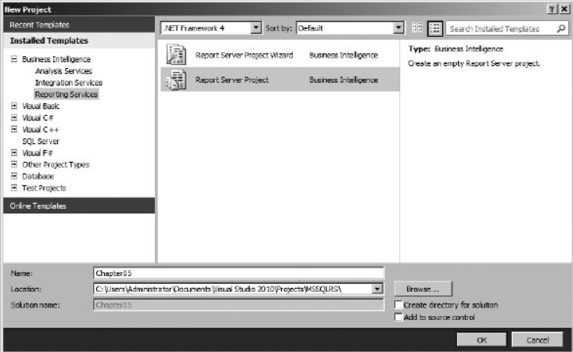
Exercise 1
Transport List Report, Task 1: Create the Chapter05 Project, Create a Shared Data Source, and Create a New Report in the Chapter05 Project
Make sure the Create directory for solution check box is unchecked. The New Project dialog box should now look like this:

Slide 6
Exercise 1
Transport List Report, Task 1: Create the Chapter05 Project, Create a Shared Data Source, and Create a New Report in the Chapter05 Project
Click OK in the New Project dialog box. A new project is created.
In the Solution Explorer on the right side of the screen, right-click the Shared Data Sources folder. Select Add New Data Source from the context menu.
Type Galactic for Name. Click Edit. The Connection Properties dialog box appears.
Type the name of the Microsoft SQL Server database server hosting the Galactic database in the Server or file name text box. If the Galactic database is hosted by the computer you are currently working on, you may type (local) for the server name.
Select the Use SQL Server Authentication radio button.
Type GalacticReporting for the user name.
Type G@l@ct1c for the password.
Check the Save my password check box.
Select Galactic from the Select or enter a database name drop-down list.
Click Test Connection. If the message, “Test connection succeeded” appears, click OK. If an error message appears, make sure the name of your database server, the user name, the password, and the database are entered properly.

Slide 7
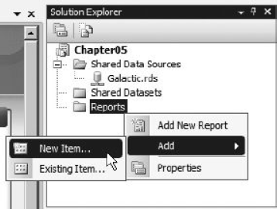
Exercise 1
Transport List Report, Task 1: Create the Chapter05 Project, Create a Shared Data Source, and Create a New Report in the Chapter05 Project
Click OK to exit the Connection Properties dialog box. Click OK again to exit the Shared Data Source Properties dialog box. A new shared data source called Galactic.rds is created in the Chapter05 project.
In the Solution Explorer, right-click the Reports folder.
Put your mouse pointer over Add in the context menu, and wait for the submenu to appear. Select the New Item command from the context menu, as shown here.

Slide 8
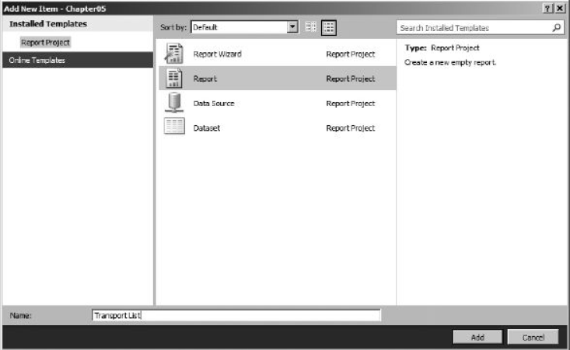
Exercise 1
Transport List Report, Task 1: Create the Chapter05 Project, Create a Shared Data Source, and Create a New Report in the Chapter05 Project
The Add New Item - Chapter05 dialog box appears. Make sure the Report icon is selected in the Templates area. Enter Transport List for the name. The dialog box appears as shown below.
Click Add. A new report called TransportList.rdl is created in the Chapter05 project.

Slide 9
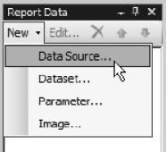
Exercise 1
Transport List Report, Task 1: Create the Chapter05 Project, Create a Shared Data Source, and Create a New Report in the Chapter05 Project
In the Report Data window, click the New drop-down menu. Select Data Source from the menu that appears. The Data Source Properties dialog box appears.
Enter Galactic for the name.
Select the Use shared data source reference radio button, and select Galactic from the drop-down list below it. Click OK. An entry for the Galactic data source appears in the Report Data window.
In the Report Data window, right-click the entry for the Galactic data source, and select Add Dataset from the context menu. The Dataset Properties dialog box appears.
Enter TransportList for the name.

Slide 10
Exercise 1
Transport List Report, Task 1: Create the Chapter05 Project, Create a Shared Data Source, and Create a New Report in the Chapter05 Project
Click the Query Designer button. The Query Designer window opens, displaying the Generic Query Designer. We use the Generic Query Designer in Chapter 6. For now, we switch to the Graphical Query Designer and all the helpful tools it provides.

Slide 11
Exercise 1
Transport List Report, Task 2: Create a Dataset
Right-click in the diagram pane (the upper area) of the Graphical Query Designer screen. Select Add Table from the context menu.
Add the following tables to the query:
Transport
TransportType
Repair
Click Close to exit the Add Table dialog box.
Right-click the diamond on the connection between the Transport table and the Repair table. You may need to rearrange the TransportType table, the Transport table, and the Repair table to see this diamond. Select the Select All Rows from Transport item from the context menu.
Check the following columns in the TransportType table:
Description
CargoCapacity
Range

Slide 12
Exercise 1
Transport List Report, Task 2: Create a Dataset
Check the following columns in the Transport table:
SerialNumber
PurchaseDate
RetiredDate
Check the following column in the Repair table:
BeginWorkDate
In the criteria pane (the second area from the top), type 1 in the Sort Order column across from the Description field and type 2 in the Sort Order column across from the SerialNumber field.
The business need for this report states it is to include only active transports. That means we only want to include transports that do not have a retired date. Type IS NULL in the Filter column across from the RetiredDate field. Remove the check mark under the Output column across from the RetiredDate field.
Right-click in the SQL pane (the third area from the top), and select Execute SQL from the context menu. In the results pane (the bottom area), notice that several records appear for serial number P-348-23-4532-22A. Your screen should look like the following illustration.

Slide 13
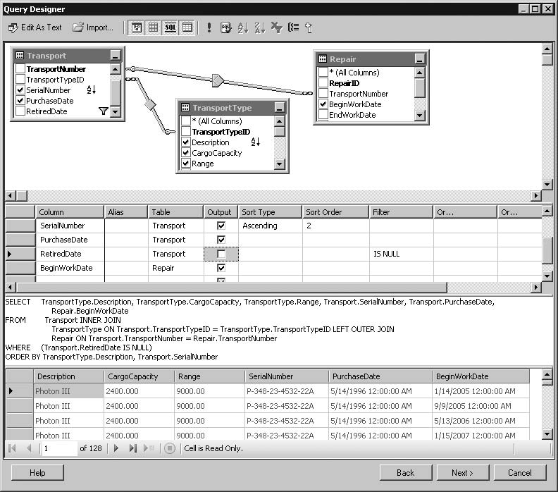
Exercise 1
Transport List Report, Task 2: Create a Dataset
Right-click in the diagram pane of the Graphical Query Designer screen. Select Add Group By from the context menu. A new column called Group By is added to the criteria pane.
In the criteria pane, click in the Group By column across from BeginWorkDate.

Slide 14
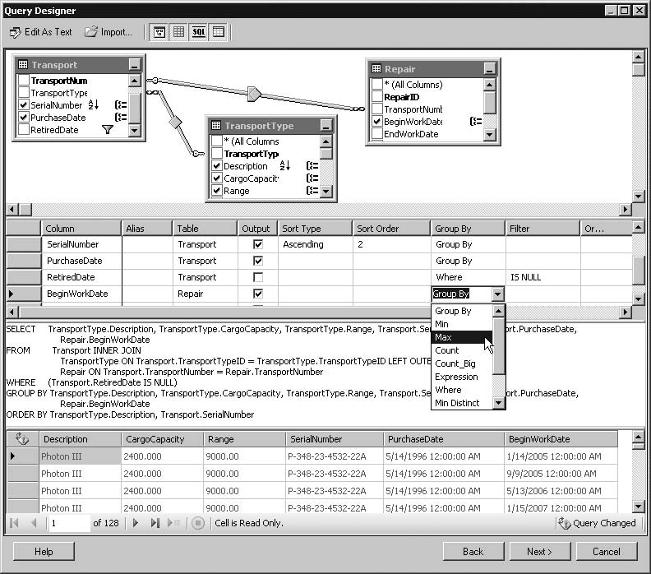
Exercise 1
Transport List Report, Task 2: Create a Dataset
Use the drop-down list in this cell to select Max, as shown here.
When you move your cursor out of the Group By column, Expr 1 will be assigned as the alias for BeginWorkDate. Replace Expr1 with LatestRepairDate in the Alias column across from BeginWorkDate.
Right-click in the SQL pane, and select Execute SQL from the context menu. Notice that now only one record appears for serial number P-348-23-4532-22A.

Slide 15
Exercise 1
Transport List Report, Task 3: Place a Table Item on the Report and Populate It
Click OK to exit the Query Designer window. Click OK to exit the Dataset Properties dialog box and begin working on the report layout.
Click the Table report item in the Toolbox. The mouse pointer changes to a table icon and crosshairs when you move your mouse pointer over the report layout area, as shown in the next illustration.

Slide 16
Exercise 1
Transport List Report, Task 3: Place a Table Item on the Report and Populate It
Drag the mouse over the lower three-quarters of the design surface, as shown in the following illustration.
When you release the mouse button after dragging, a table is created to occupy the area you just defined. By default, every cell in the table is occupied by an empty text box. Click in each cell of the table, and note the name and type of report item shown at the top of the Properties window.

Slide 17
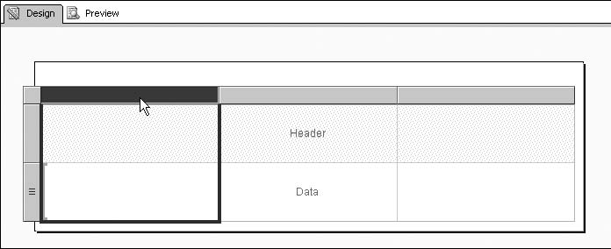
Exercise 1
Transport List Report, Task 3: Place a Table Item on the Report and Populate It
Let’s take a few moments to go over the methods for selecting various parts of the table. You have already seen how to select individual cells. When you click the table, gray borders appear on top of and to the left of the table item. These borders provide handles for selecting other parts of the table. Click the table, and then click any of the gray rectangles in the border above the table item. This action selects the corresponding column, as shown in the following illustration.

Slide 18
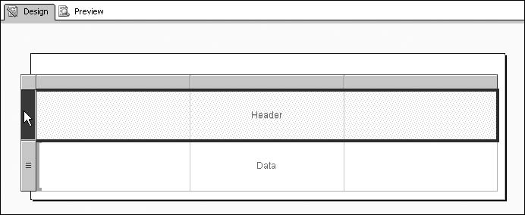
Exercise 1
Transport List Report, Task 3: Place a Table Item on the Report and Populate It
Click any of the gray rectangles in the border to the left of the table item. This action selects a row, as shown here.
Click the gray square in the upper-left corner of the border. This action selects the entire table. When the entire table is selected, the gray border is replaced by the sizing handles (the small white squares) for the table. You must select the entire table before you can move and size the table item. Note in the Properties window the item is called a tablix rather than a table.

Slide 19
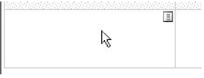
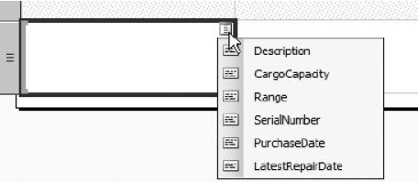
Exercise 1
Transport List Report, Task 3: Place a Table Item on the Report and Populate It
Hover your cursor over the lower-left table cell. A small icon representing the Field Selector will appear, as shown here.
Click the icon. The Field Selector, a list of the fields defined in your dataset, is displayed, as shown here.

Slide 20
Exercise 1
Transport List Report, Task 3: Place a Table Item on the Report and Populate It
Select the SerialNumber field from the Field Selector. An expression that returns the value of the SerialNumber field is placed in the text box that occupies the lower-left table cell. This is represented by the name of the field enclosed in square brackets. The name of the field is also used to create a column heading in the upper-left table cell.
Repeat this process in the lower cell in the center column of the table to select the PurchaseDate field from the Field Selector.
Repeat the process once more in the lower-right table cell to select the LatestRepairDate field from the Field Selector. The report layout should now appear as shown.

Slide 21
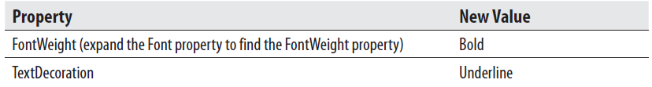
Exercise 1
Transport List Report, Task 3: Place a Table Item on the Report and Populate It
Select the header row (the top row) by clicking the gray rectangle in the border to the left of the row.
Make the following changes in the Properties window:
In the gray border to the left of the table, click the line between the header row and the data row. Drag it to reduce the height of the header row.
In the gray border to the left of the table, click the bottom of the data row rectangle. Drag it to reduce the height of the data row.

Slide 22
Exercise 1
Transport List Report, Task 3: Place a Table Item on the Report and Populate It
Click the center cell in the data row. Hold down shift and click the right cell in the data row. Both of these cells are now selected. Make the following changes in the Properties window:
Click the Preview tab to preview the report. The report should appear as shown here.

Slide 23
Exercise 1
Transport List Report, Task 4: Add Table Grouping and Other Report Formatting
Click the Design tab. Notice there is one entry in the Row Groups section of the Grouping pane at the bottom of the Design tab. We will add a second row group to display the transport type.
Click the drop-down arrow in the Row Groups pane, as shown here.
From the menu that appears, select Add Group | Parent Group. The Tablix Group dialog box appears.
Select [Description] from the Group by drop-down list.
Check the Add group header check box.
Click OK. A new column and a new row are added to the table. Note that by default the group is named after the grouping column, so this group is named Description. There is now a Description entry in the Row Groups pane. The field we selected as the group expression provides the value in this new column.

Slide 24
Exercise 1
Transport List Report, Task 4: Add Table Grouping and Other Report Formatting
Select the cell in the upper-left corner of the table. This is the cell containing the word “Description” bold and underlined. Click the cell a second time so the blinking text-edit cursor appears in that cell.
Delete Description and type the following:
Transport Type
Select the table cell containing the Description field.
Make the following changes in the Properties window:

Slide 25
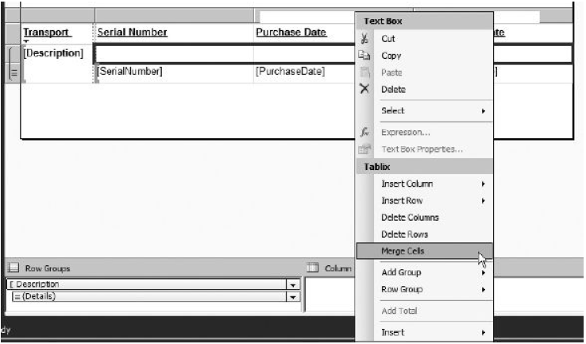
Exercise 1
Transport List Report, Task 4: Add Table Grouping and Other Report Formatting
Click the empty table cell immediately below the Serial Number heading. Hold down shift, and then click the center and the rightmost cells in the same row. Right-click in any of the selected cells, and select Merge Cells from the Tablix section of the context menu, as shown here.

Slide 26
Exercise 1
Transport List Report, Task 4: Add Table Grouping and Other Report Formatting
Right-click in the newly merged cells, and select Expression from the Textbox section of the context menu. The Expression dialog box appears.
Type the following after the equal sign (=), including the quotation marks, in the Set expression for: Value area:
"Cargo Capacity: " & CStr(
Select the Fields (TransportList) entry in the tree view in the Category area of the dialog box. Note the fields in the selected dataset appear in the Values area of the dialog box.

Slide 27
Exercise 1
Transport List Report, Task 4: Add Table Grouping and Other Report Formatting
Double-click the CargoCapacity field to append it to the expression. Note an expression is created, which returns the value of the CargoCapacity field.

Slide 28
Exercise 1
Transport List Report, Task 4: Add Table Grouping and Other Report Formatting
Type ) at the end of the expression in the Set expression for: Value area and press enter. Type the following:
& vbCrLf & "Range: " & CStr(
Double-click the Range field to append it to the expression in the Set expression for: Value area.
Type a ) at the end of the expression. The Expression dialog box should appear as shown.

Slide 29
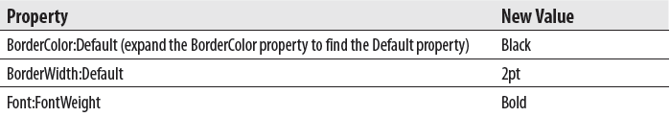
Exercise 1
Transport List Report, Task 4: Add Table Grouping and Other Report Formatting
Click OK. Note the “<<Expr>>” in the merged cells indicates the value being displayed in this area of the report does not come from a single field, but from an expression.
With the merged cells still selected, make the following changes in the Properties window:
Click the Textbox report item in the Toolbox. The mouse pointer changes to a text box icon and crosshairs when you move your mouse pointer over the design surface.

Slide 30
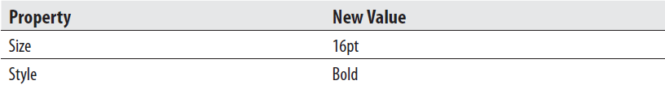
Exercise 1
Transport List Report, Task 4: Add Table Grouping and Other Report Formatting
Drag the mouse cursor over the entire area above the table on the design surface.
Right-click the selected expression and select Text Box Properties from the context menu. The Text Box Properties dialog box appears.
On the General page of the dialog box, Type the following for Value:
Transport List
On the Alignment page of the dialog box, select Center from the Horizontal drop-down list.
On the Font page of the dialog box, make the following changes:

Slide 31
Exercise 1
Transport List Report, Task 4: Add Table Grouping and Other Report Formatting
Click OK to exit the Text Box Properties dialog box.
Click the Preview tab. The report should appear as shown below.
Click Save All in the toolbar.

Slide 32
The Tablix and Data Regions
In the report we just completed, when we dragged a table from the Toolbox onto the design surface, we actually ended up with a report item called a tablix.
A tablix provides the capabilities of a table and a matrix combined into one.
When we selected a table from the toolbox, what we really did was select a template that creates a tablix that functions like a table.
When we select a matrix from the toolbox, as we will do in our next report, we really select a template that creates a tablix that functions like a matrix.
In the same manner, the list is a template that creates a tablix that functions like a freeform list.
The tablix, when functioning like a freeform list, is not limited to rows and columns. It creates a whole section, perhaps a whole page, of layout for each record in the dataset.

Slide 33
The Tablix and Data Regions
These templates help us start work on a particular type of report layout, table, matrix, or list.
The templates do not, however, change the functionality of the tablix that appears as part of our report.
They just help configure some of the initial settings for the tablix so it looks a certain way.
We could start with the table template and end up with a tablix that functions more like a matrix. Or we could start with a matrix template and end up with a tablix that functions more like a table. Underneath it all, a tablix is a tablix is a tablix.
The tablix is one of three special report items designed specifically for working with datasets.
These special report items are called data regions. The other data regions are the chart and the gauge.
The tablix creates mainly textual layout for each record in the dataset.
The chart and gauge data regions create mainly graphical layout for the records in the dataset.

Slide 34
The Tablix and Data Regions
Each data region item has a property called DataSetName.
This property contains the name of the dataset used by the data region.
In the Transport List report you just created, the DataSetName property of the tablix has the value TransportList.
Each data region always works with one and only one dataset.
However, a given dataset can be used by multiple data regions within the same report.
For example, you could create a report containing both a tablix data region and a chart data region to present the data from a single dataset in both a textual and a graphical layout.
Next we will create a matrix report without the wizard.

Slide 35
The Repair Count By Type Report
Features Highlighted
Creating a matrix report from scratch
Using the Property Pages button
Business Need - GDS needs to purchase several new transports to update their delivery fleet. The company must decide which type of transport to purchase. One factor in the decision is the amount of time the new transports will spend in the maintenance hangar for repairs and preventative maintenance. Upper management has asked the GDS maintenance department to provide a report showing the number of each type of repair required by each type of transport. The report should include statistics from all transports, both active and retired. Also, the report should group the repairs by their cause.
Task Overview
Create a New Report, Select the Shared Data Source, and Create a Dataset
Place a Matrix Item on the Report and Populate It
Add Column Grouping and Other Report Formatting

Slide 36
Exercise 2
Repair Count By Type Report, Task 1: Create a New Report, Select the Shared Data Source, and Create a Dataset
If you closed the Chapter05 project, reopen it.
In the Solution Explorer on the right side of the screen, right-click the Reports folder.
Put your mouse pointer over Add in the context menu, and wait for the submenu to appear. Select New Item from the context menu. This displays the Add New Item - Chapter05 dialog box.
Make sure the Report icon is selected in the Templates area. Enter RepairCountByType for the name.
Click Add. A new report called RepairCountByType.rdl is created in the Chapter05 project.
In the Report Data window, click the New drop-down menu. Select Data Source from the menu that appears. The Data Source Properties dialog box appears.
Enter Galactic for the name.
Select the Use shared data source reference radio button. and select Galactic from the drop-down list below it. Click OK. An entry for the Galactic data source appears in the Report Data window.

Slide 37
Exercise 2
Repair Count By Type Report, Task 1: Create a New Report, Select the Shared Data Source, and Create a Dataset
In the Report Data window, right-click the entry for the Galactic data source, and select Add Dataset from the context menu. The Dataset Properties dialog box appears.
Enter RepairsByType for the name.
Click the Query Designer button. The Query Designer window opens, displaying the Generic Query Designer.
Right-click in the diagram pane of the Graphical Query Designer screen. Select Add Table from the context menu.
Add the following tables to the query:
Repair
Transport
TransportType
RepairWorkDoneLink
WorkDone
RepairCause

Slide 38
Exercise 2
Repair Count By Type Report, Task 1: Create a New Report, Select the Shared Data Source, and Create a Dataset
Click Close to exit the Add Table dialog box.
Check the following column in the Repair table:
RepairID
Check the following column in the TransportType table: Description
In the criteria pane, type TypeOfTransport in the Alias column in the Description row.
Check the following column in the WorkDone table:
Description
In the criteria pane, type TypeOfWork in the Alias column in the Description row for the WorkDone table.
Check the following column in the RepairCause table:
Description
In the criteria pane, type RepairCause in the Alias column in the Description row for the RepairCause table.
Type 1 in the Sort Order column for RepairCause. Type 2 in the Sort Order column for TypeOfWork.
Right-click in the SQL pane, and select Execute SQL from the context menu.

Slide 39
Exercise 2
Repair Count By Type Report, Task 2: Place a Matrix Item on the Report and Populate It
Click OK to exit the Query Designer window. Click OK to exit the Dataset Properties dialog box.
Click the Matrix report item in the Toolbox. The mouse pointer changes to a matrix icon and crosshairs when you move the mouse pointer over the design surface.
Drag the mouse cursor over the lower three-quarters of the design surface.
When you release the mouse button after dragging, a matrix is created to occupy the area you just defined. By default, every cell in the matrix is occupied by an empty text box.
Hover over the cell containing the word “Columns” until the Field Selector icon appears. Click the icon and select the TypeOfTransport field. The values in the TypeOfTransport column of the dataset determine the columns in the matrix report.
Use the same process in the cell containing the word “Rows” to select the TypeOfWork field. The values in the TypeOfWork column of the dataset determine the rows in the matrix report.
Use the same process once more in the cell containing the word “Data” to select the RepairID field.

Slide 40
Exercise 2
Repair Count By Type Report, Task 2: Place a Matrix Item on the Report and Populate It
Right-click the cell you worked on in Step 7, and select Expression from the Textbox section of the context menu. The Expression dialog box appears.
Change the word “Sum” to “Count” so the contents of the expression appear as follows:
=Count(Fields!RepairID.Value)
Click OK to exit the Expression dialog box.
With this cell still selected, change the following property in the Properties window:

Slide 41
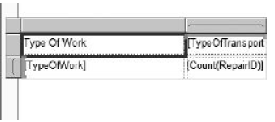
Exercise 2
Repair Count By Type Report, Task 2: Place a Matrix Item on the Report and Populate It
Reduce the width and height of the columns in the matrix. When you finish, your report design should look similar to this:
Click the Preview tab.

Slide 42
Exercise 2
Repair Count By Type Report, Task 3: Add Column Grouping and Other Report Formatting
Click the Design tab to return to the report layout.
In the Rows Groups area of the Grouping pane, click the drop-down arrow and select Add Group | Parent Group from the menu. The Tablix group dialog box appears.
Select [RepairCause] from the Group by drop-down list. Click OK.
Make the Repair Cause group column approximately twice as wide as its default width.
Select the text box containing the RepairCause field (not the text box where you just typed “Repair Cause” as a heading).
In the Properties window, click the Property Pages button shown in the following illustration. The Text Box Properties dialog box appears.

Slide 43
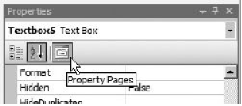
Exercise 2
Repair Count By Type Report, Task 3: Add Column Grouping and Other Report Formatting
Replace the current content of Name with txtRepairCause. Click OK. We give this text box an explicit name because we reference it in just a moment.
In the Row Groups area, right-click the TypeOfWork entry and select Group Properties from the context menu. The Group Properties dialog box appears.
Select the Visibility page. Set the When the report is initially run radio buttons group to Hide. Check the Display can be toggled by this report item check box, and select txtRepairCause from the associated drop-down list. The Group Properties dialog box should appear as shown in next slide.

Slide 44
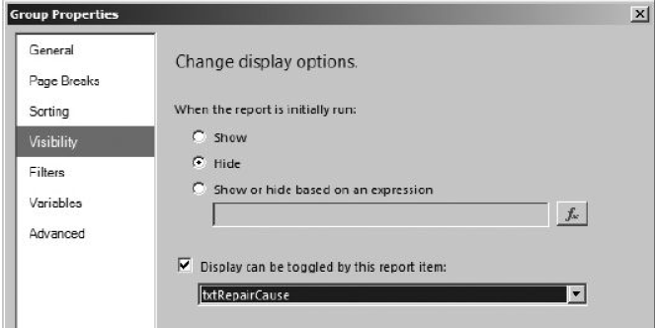

Exercise 2
Repair Count By Type Report, Task 3: Add Column Grouping and Other Report Formatting
Click OK in the Group Properties dialog box.
Click the gray rectangle to the left of the upper row in the tablix to select this entire row. Change the following properties in the Properties window:

Slide 45
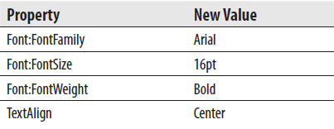
Exercise 2
Repair Count By Type Report, Task 3: Add Column Grouping and Other Report Formatting
Click the Textbox report item in the Toolbox. Drag the mouse cursor over the area above the matrix on the design surface. When you release the mouse button after dragging, a text box is created to occupy the area you just defined. Doubleclick the text box and type the following:
Repair Count By Type Report
Press ESC to leave text-edit mode and select the text box. Make the following changes in the Properties window:

Slide 46
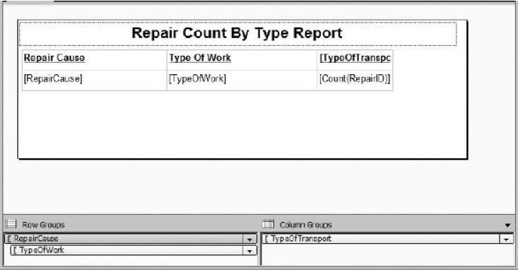
Exercise 2
Repair Count By Type Report, Task 3: Add Column Grouping and Other Report Formatting
Your report layout should appear similar to the illustration.

Slide 47
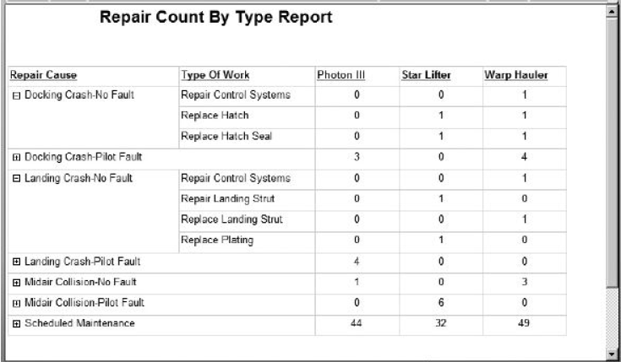
Exercise 2
Repair Count By Type Report, Task 3: Add Column Grouping and Other Report Formatting
Click the Preview tab. Try expanding some of the drilldown sections. The report should appear as follows.
Click Save All in the toolbar.

Slide 48
New Territory
Now that you have created the table and matrix reports without the aid of the Report Wizard, it is time to venture into new territory.
We will move on to create a list report.
List reports are used when you need to repeat a large area of content—perhaps even an entire page—for each record in the dataset.
They are often used to create forms.
List reports function similarly to a mail merge in a word-processing program, such as Microsoft Word.

Slide 49
The Transport Information Sheet
Features Highlighted
Creating a list report
Business Need - The GDS maintenance department needs an efficient way to look up general information about a particular transport that comes in for repair. The user should be able to select the serial number from a drop-down list and see all the basic information about the transport. This transport information sheet should also include the date of the next scheduled maintenance appointment for this transport.
Task Overview
Create a New Report, Select the Shared Data Source, and Create the TransportSNs Dataset
Create the TransportDetail Dataset.
Place a List Item on the Report and Populate It.

Slide 50
Exercise 3
Transport Information Sheet, Task 1: Create a New Report, Select the Shared Data Source, and Create the TransportSNs Dataset
If you closed the Chapter05 project, reopen it.
In the Solution Explorer on the right side of the screen, right-click the Reports folder. Select Add | New Item. This displays the Add New Item-Chapter05 dialog box.
Make sure the Report icon is selected in the Templates area. Enter TransportInfoSheet for the name. Click Add.
In the Report Data window, click the New drop-down menu. Select Data Source from the menu that appears. The Data Source Properties dialog box appears.
Enter Galactic for the name.
Select the Use shared data source reference radio button, and select Galactic from the drop-down list below it. Click OK. An entry for the Galactic data source appears in the Report Data window.

Slide 51
Exercise 3
Transport Information Sheet, Task 1: Reopen the Chapter05 Project, Create a New Report in the Chapter05 Project, Select the Shared Data Source, and Create the TransportSNs Dataset
In the Report Data window, right-click the entry for the Galactic data source, and select Add Dataset from the context menu. The Dataset Properties dialog box appears.
Enter TransportSNs for the name.
Click the Query Designer button. The Query Designer window opens, displaying the Generic Query Designer.
Enter the following in the upper portion of the Generic Query Designer window:
SELECT SerialNumber FROM Transport WHERE RetiredDate IS NULL ORDER BY SerialNumber
Click the Run toolbar button (the red exclamation mark).
Click OK to exit the Query Designer window. Click OK to exit the Dataset Properties dialog box.

Slide 52
Exercise 3
Transport Information Sheet, Task 2: Create the TransportInfo Dataset
Right-click the Galactic data source entry in the Report Data window, and select Add Dataset from the context menu The Dataset Properties dialog box appears.
Enter TransportDetail for the name.
Click the Query Designer button to display the Query Designer window.
Right-click in the diagram pane of the Graphical Query Designer screen. Select Add Table from the context menu. Add the following tables to the query:
Transport
TransportType
ScheduledMaint
Repair
Click Close to exit the Add Table dialog box.

Slide 53
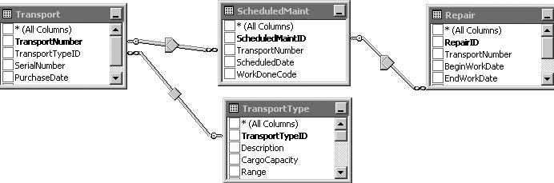
Exercise 3
Transport Information Sheet, Task 2: Create the TransportInfo Dataset
Right-click the link between the Transport and the Repair tables, and then select Remove from the context menu.
Right-click the diamond in the middle of the link between the Repair table and the ScheduledMaint table. Choose Select All Rows from ScheduledMaint in the context menu.
Find the diamond in the middle of the link between the Transport and ScheduledMaint tables. Right-click this diamond and choose Select All Rows from Transport from the context menu. The diagram pane should look similar to the illustration.

Slide 54
Exercise 3
Transport Information Sheet, Task 2: Create the TransportInfo Dataset
Check the following columns in the Transport table:
SerialNumber
PurchaseDate
Check the following columns in the TransportType table:
Description
CargoCapacity
Range
Cost
Crew
Manufacturer
ManAddr1
ManAddr2
ManCity
ManState
ManZipCode
ManPlanetAbbrv
ManEmail
Check the following column in the ScheduledMaint table:
ScheduledDate

Slide 55
Exercise 3
Transport Information Sheet, Task 2: Create the TransportInfo Dataset
Check the following column in the Repair table:
RepairID
In the criteria pane, type the following in the Filter column for SerialNumber:
= @SerialNumber
In the Filter column for RepairID, type this:
IS NULL
Right-click in the diagram pane, and select Add Group By from the context menu.
In the criteria pane, in the Group By column for ScheduledDate, select Min from the drop-down list.
In the Alias column for ScheduledDate, change Expr1 to NextMaintDate.

Slide 56
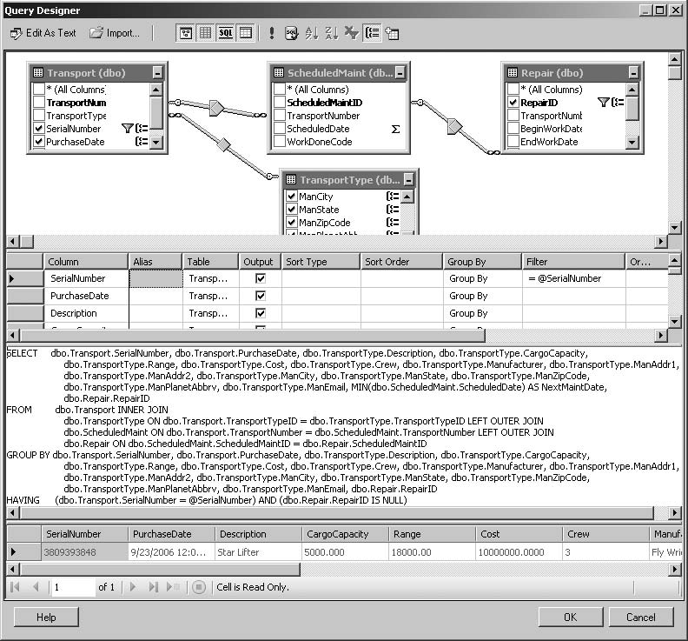
Exercise 3
Transport Information Sheet, Task 2: Create the TransportInfo Dataset
Right-click in the SQL pane, and select Execute SQL from the context menu. Enter 3809393848 for the @SerialNumber parameter, and click OK. The Graphical Query Designer should appear similar to the next illustration.

Slide 57
Exercise 3
Transport Information Sheet, Task 3: Place a List Item on the Report and Populate It
Click OK to exit the Query Designer window. Click OK to exit the Dataset Properties dialog box.
In the Report Data window, expand the Parameters folder.
Right-click the entry for SerialNumber, and select Parameter Properties from the context menu. The Report Parameter Properties dialog box appears.
Select the Available Values page.
Select the Get values from a query radio button.
Select TransportSNs from the Dataset drop-down list.
Select SerialNumber from the Value field drop-down list. Select SerialNumber from the Label field drop-down list as well.
Click OK to exit the Report Parameter Properties dialog box.
Move your mouse pointer to the bottom of the white design surface so it changes from the regular mouse pointer to the double-headed arrow. The white design surface is the body of the report.

Slide 58
Exercise 3
Transport Information Sheet, Task 3: Place a List Item on the Report and Populate It
Drag the bottom of the report body down to create more room to lay out the list report.
Select the Toolbox window, and click the List report item. The mouse pointer changes to a list icon and crosshairs when you move your mouse pointer over the design surface.
Drag the mouse cursor over the entire report body.
When you release the mouse button after dragging, a list is created to occupy the area you just defined.
Drag a text box from the Toolbox, and drop it inside the list at the top. The list will become selected as you drag the text box on to it. This text box will be the title.
Click this new text box so the blinking text-edit cursor appears. Type Transport Information Sheet in the textbox. Press esc to leave text-edit mode and select the text box.

Slide 59
Exercise 3
Transport Information Sheet, Task 3: Place a List Item on the Report and Populate It
As an alternative to the Properties window, font and text alignment properties can be set using the toolbar buttons similar to working in Microsoft Word or Microsoft Excel. Use the toolbar to set the properties of the text box as follows:
Place a second text box under the existing title. Type Serial Number: in this text box. Size the text box so it just fits this text. This serves as the label for the Serial Number field.
In the Report Data window, expand the Galactic data source and the TransportDetail dataset. Drag the SerialNumber field from the Report Data window and place it to the right of the text box that was added in Step 17. Click the sizing handle on the right side of this new text box to make it approximately twice its original size.

Slide 60
Exercise 3
Transport Information Sheet, Task 3: Place a List Item on the Report and Populate It
Now use the positioning handle (the square with the four arrow heads) to position the text box relative to the text box containing the “Serial Number:” label. When the two text boxes are aligned, you will see alignment lines appear between the two text boxes, as shown here.
Drag a line from the Toolbox, and drop it inside the list below the text box containing the “Serial Number:” label.
Drag the end points of the line so it goes across the entire list below the Serial Number: text boxes.

Slide 61
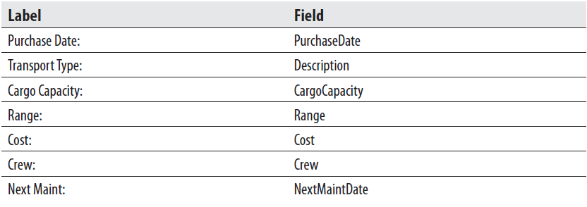
Exercise 3
Transport Information Sheet, Task 3: Place a List Item on the Report and Populate It
Repeat Step 17 through Step 19 for each of the following fields, creating a label for the field and then placing the field to the right of the label. (Hint: You may want to create all the labels first and then add all the fields so you are not switching back and forth between the Toolbox window and the Report Data window.)

Slide 62
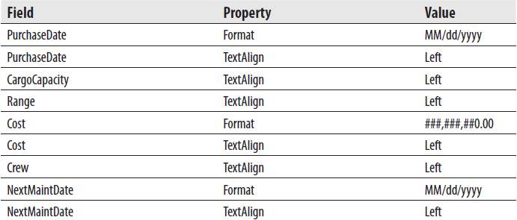
Exercise 3
Transport Information Sheet, Task 3: Place a List Item on the Report and Populate It
Use either the Report Formatting toolbar or the Properties window to set the properties for these fields as follows (these properties are for the fields themselves, not the labels):
Drag a rectangle from the Toolbox, and drop it inside the list below the bottommost text box. Size the rectangle so it covers the remaining area of the list.

Slide 63

Exercise 3
Transport Information Sheet, Task 3: Place a List Item on the Report and Populate It
Use the Report Borders toolbar, shown here, to set the properties for the border of the rectangle. Make sure the toolbar items are set to Solid, 1pt, and Black.
Click the Outside Border toolbar button, indicated here by the mouse pointer, to create a solid, 1-point-wide, black border on all sides of the rectangle.
Drag a text box from the Toolbox, and place a text box in the upper-left corner of the rectangle. Type Manufacturer: in this text box. This is the manufacturer label.
Drag the Manufacturer field from the Report Data window, and place it inside the rectangle to the right of the manufacturer label. Align the Manufacturer field text box with the manufacturer label text box, and size the field text box so it goes almost all the way to the right side of the rectangle. If you drag too far to the right, the Report Designer automatically increases the size of the body of the report. If this happens, simply reduce the width of the body of the report.

Slide 64
Exercise 3
Transport Information Sheet, Task 3: Place a List Item on the Report and Populate It
Place the ManAddr1 and ManAddr2 fields below the Manufacturer field. Make these new fields the same size as the Manufacturer field.
Place the ManCity field inside the rectangle, below the ManAddr2 field. Make this new field the same size as the ManAddr2 field.
Click on "[ManCity]" in the text box added in step 30 to select that text, and then right-click on this selected text. Select Expression from the context menu. The Expression dialog box appears. Type the following expression in the Set expression for: Value area:
=Fields!ManCity.Value & ", " & Fields!ManState.Value & " " &
Fields!ManZipCode.Value & " " &Fields!ManPlanetAbbrv.Value
Click OK to exit the Expression dialog box.
Drag the ManEmail field from the Report Data window, and place it inside the rectangle under the text box added in Step 26. Make this text box as wide as the text boxes above it.

Slide 65
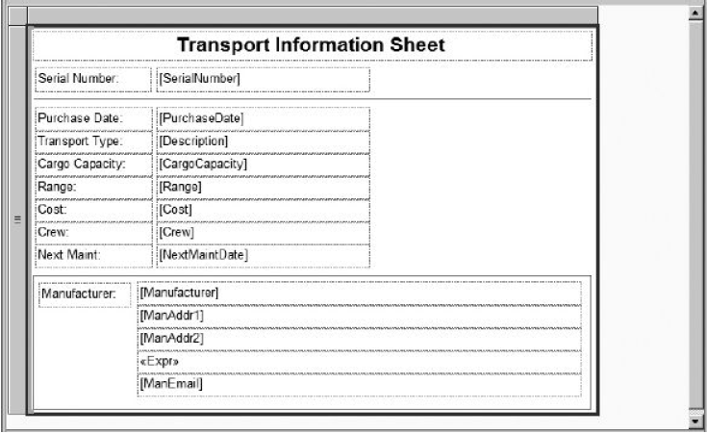
Exercise 3
Transport Information Sheet, Task 3: Place a List Item on the Report and Populate It
Your report layout should appear similar to the following illustration:
Click the Preview tab.

Slide 66
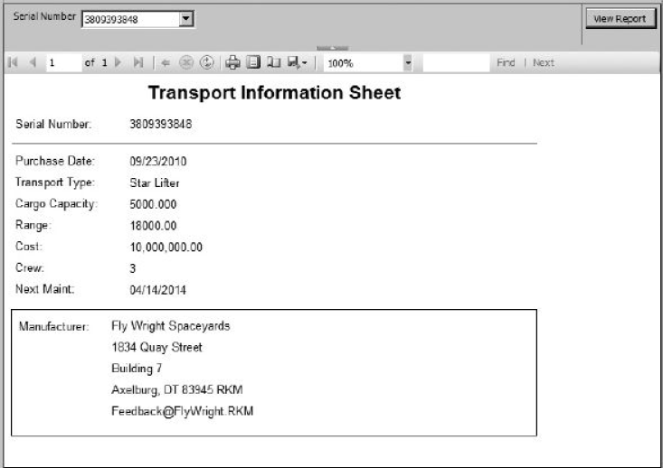
Exercise 3
Transport Information Sheet, Task 3: Place a List Item on the Report and Populate It
Select the first serial number from the Serial Number drop-down list, and click View Report. Your report should appear similar to the illustration.
Click the Save All button on the toolbar.

